Slide 1

(Aug 24th – 30th 2020)
Mrs. Ben Mathews
Aleena Sajan
Marys Vineeta Paul
Diya Susan Robin
Mr. Reni Varghese Thomas
Nikki Shivani Samantha Kurian
Micah Varghese Dany
Mrs. Nisha Binu
Mr. Thomas Koshy
Mrs. Reeba Mathew
Mr. Joshua Cyril
Mr. Benoy Philip

Slide 2


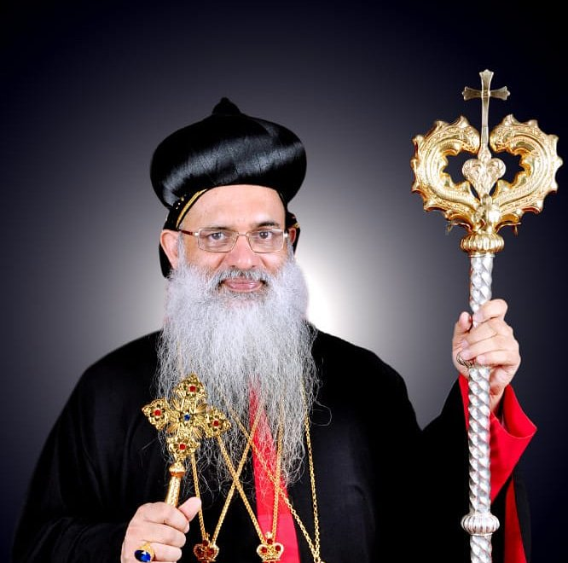
74th Birthday H.H. Moran Mor Baselios Marthoma Paulose II

Slide 3


(Aug 24th – 30th 2020)
Mr. Varughese George AND Mrs. Aliece Varughese
Mr. Varghese George AND Mrs. Rini Sara Reji
Mr. Robin Koshy AND Mrs. Ronia Sara Rajan
Mr. Elvin Abraham John AND Mrs. Achamma Elvin
Mr. Thomas Mani Padiyara AND Mrs. Nisha Thomas
Mr. Thomas Thoppil AND Mrs. Sarah Thomas
Mr. Anub Zachariah Koruthu AND Mrs. Meethu Jacob
Mr. Oommen Kandathil Mathew AND Mrs. Vidya Oommen

